Slide 1
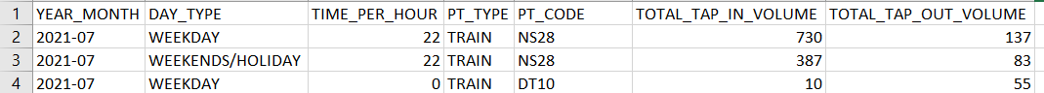
Data Collection
Data of Passenger Volume by Train Stations obtained from DataMall, an LTA Open Data initiative API.
3 months of tap in and tap out passenger volume by weekdays and weekends for each individual train station
1st three rows of the Passenger Volume by Train Stations for the July 2021.
Making sense of the data:
TIME_PER_HOUR: Hour of the day. E.g. 22 = 2200hrs to 2259hrs.
On a typical WEEKEND/HOLIDAY of July 2021, from 2200hrs to 2259hrs, at Train Station NS28, the passenger volume of tap in and tap out are 387 and 83 respectively.
40.015 Simulation Modeling and Analysis | Mass Rapid Transit System Line Simulation

Slide 2
Data Collection
Objective:
Obtain suitable passenger arrival values for our Simulation model timeseries exponential distribution.
Considerations:
The data only has a single value for passenger arrivals and exits at each station.
Each station has 2 observations - weekday and weekend.
Maximum Likelihood Estimator for Poisson arrivals = sample mean of observed hourly arrivals.
Data collected spans across 3 months - "2021-07", "2021-08", "2021-09". Note the LTA API only provides the arrival volume data from the three most recent months.
Assumptions:
Peak hours are 0600hrs to 0900hrs (morning), 1700hrs to 1900hrs (evening).
Passenger arrivals at stations connected to more than 1 line are assumed to be spilt evenly between all connected lines. E.g. Passenger arrivals at CE1/DT16 are spilt into 2 evenly.
40.015 Simulation Modeling and Analysis | Mass Rapid Transit System Line Simulation

Slide 3
Data Visualization
Combined all three csv datasets into a single large dataset.
Split the single large data set into 6 categories:
Weekday Morning Peak;
Weekday Evening Peak;
Weekday Non-Peak;
Weekend Morning Peak;
Weekend Evening Peak;
Weekend Non-Peak.
Plot Histogram with the density line over it for all 6 categories.
40.015 Simulation Modeling and Analysis | Mass Rapid Transit System Line Simulation

Slide 4
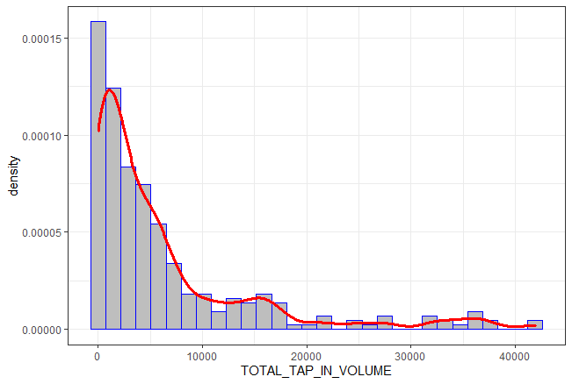
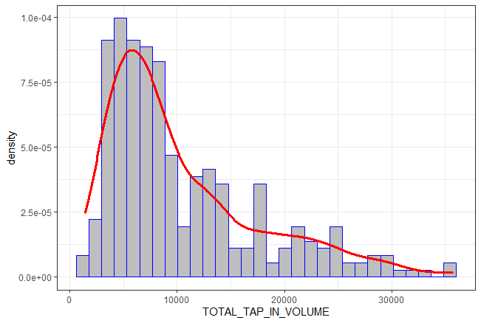
Data Visualization
Passenger Tap-In Volume for Weekday Morning Peak
Passenger Tap-In Volume for Weekday Evening Peak
40.015 Simulation Modeling and Analysis | Mass Rapid Transit System Line Simulation

Slide 5
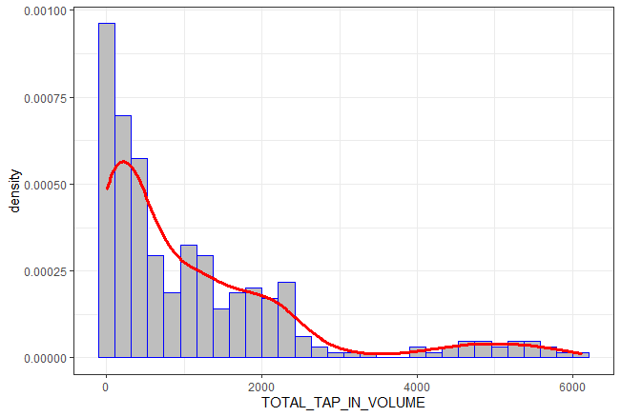
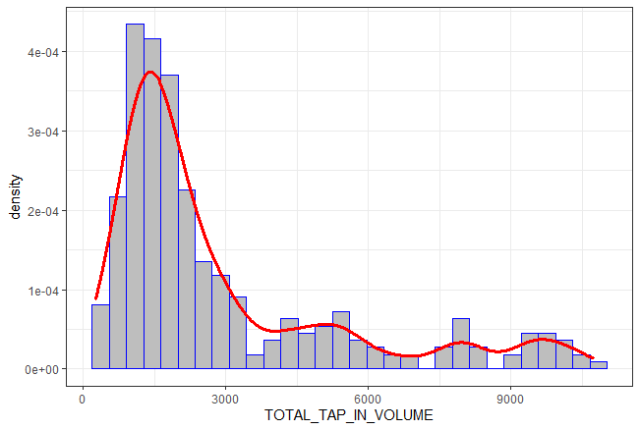
Data Visualization
Passenger Tap-In Volume for Weekend Morning Peak
Passenger Tap-In Volume for Weekend Evening Peak
40.015 Simulation Modeling and Analysis | Mass Rapid Transit System Line Simulation

Slide 6
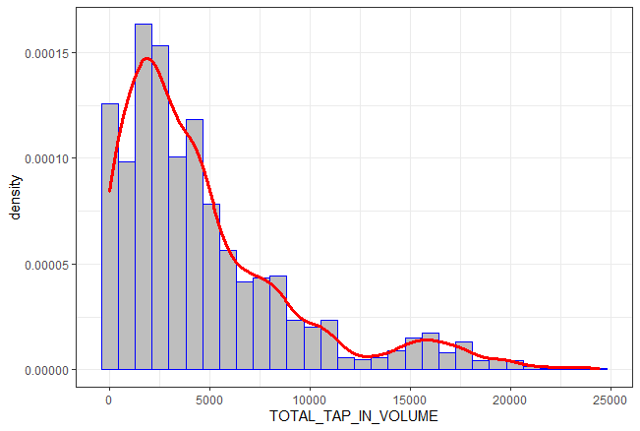
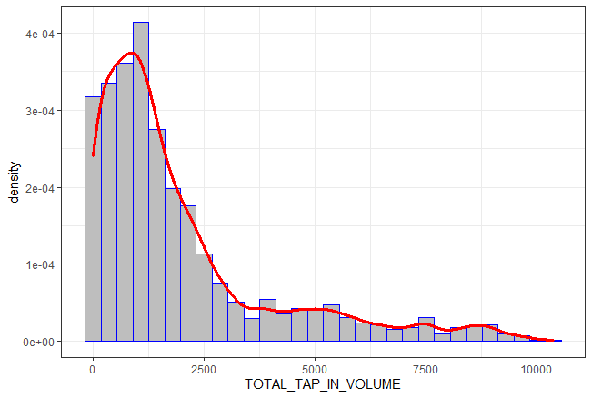
Data Visualization
Passenger Tap-In Volume for Weekday Non-Peak
Passenger Tap-In Volume for Weekend Non-Peak
40.015 Simulation Modeling and Analysis | Mass Rapid Transit System Line Simulation

Slide 7
1st Statistical Test
Objective:
To determine if the morning, evening peak hours and non-peak hours have statistically significant different number of passenger arrivals.
To validate our assumption for splitting the day into 3 different categories: morning, evening peak hours and non-peak hours when building our timeseries exponential passenger arrival distribution in JaamSim.
How is it done:
Kruskal-Wallis test used instead of ANOVA as responses are clearly not normally distributed.
Kruskal-Wallis test conducted on weekday and weekend passenger arrival for each of the 3 months, comparing the mean arrivals of morning peak hours, evening peak hours and non-peak hours.
Hence 6 Kruskal-Wallis tests were done:
3 for Weekday: July, August, September 2021;
3 for Weekend: July, August, September 2021.
40.015 Simulation Modeling and Analysis | Mass Rapid Transit System Line Simulation

Slide 8
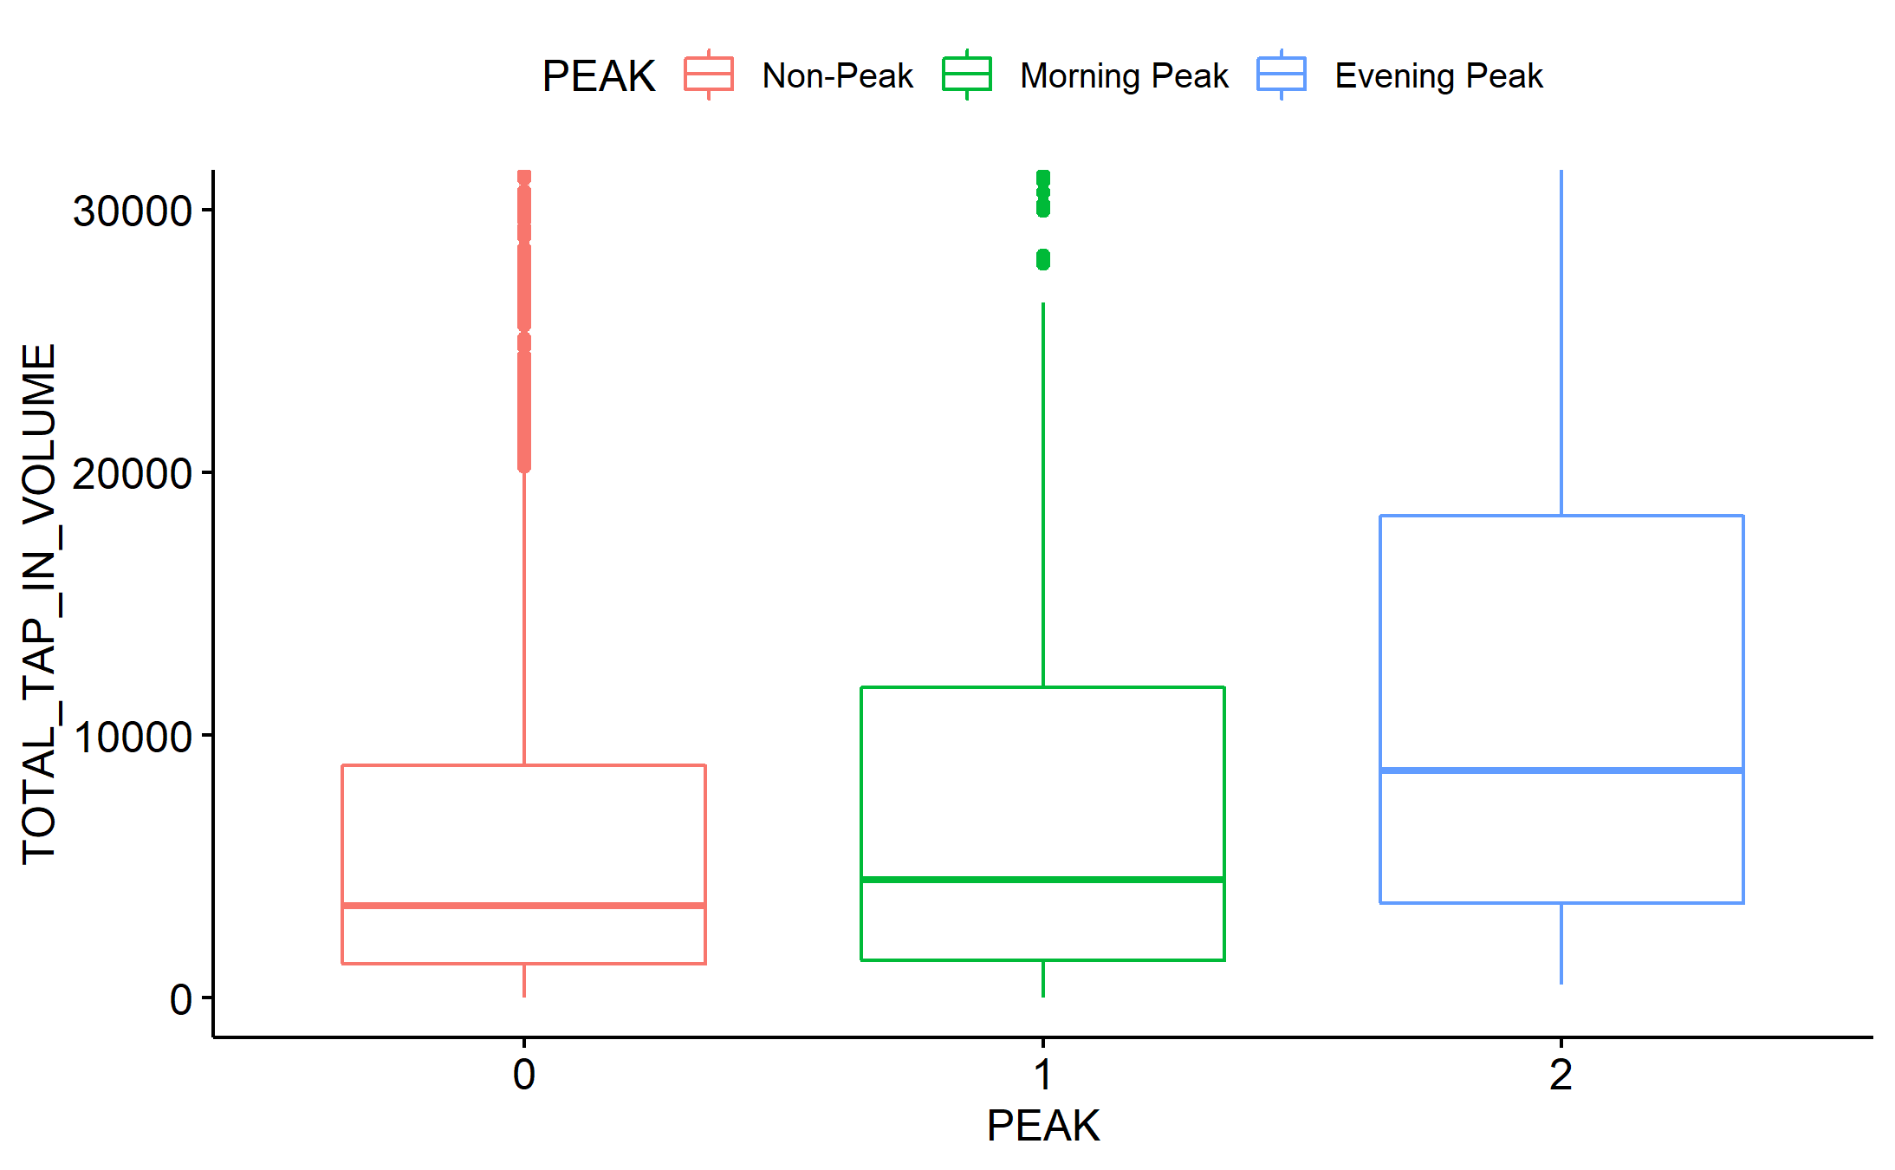
1st Statistical Test - Results
P-values for all 6 tests obtained were all smaller than 0.05.
Conclude at 95% confidence level that the mean arrivals per hour are statistically different between morning, evening peak hours and non-peak hours for every month weekdays and weekends.
Hence it is valid to split a given weekday or weekend into 3 timeframes: morning, evening peak hours and non-peak hours.
On the right is a boxplot (vertically cropped to see differences) to visualize just 1 of the 6 tests.
(Zoomed-in) Box-plot of the Passenger tap-in volume during weekday for July 2021.
40.015 Simulation Modeling and Analysis | Mass Rapid Transit System Line Simulation

Slide 9
2nd Statistical Test
Objective:
To determine if the number of passenger arrival comes from the same distribution across the 3 months.
To validate our assumption that the distribution of the number of passenger arrivals come from the same distribution.
How is it done:
Kruskal-Wallis test conducted on each of the 6 categories, comparing the mean arrivals of each month.
Hence another 6 Kruskal-Wallis tests were done:
3 for Weekday: Morning Peak hour, Evening Peak hour, Non-peak hour;
3 for Weekend: Morning Peak hour, Evening Peak hour, Non-peak hour.
40.015 Simulation Modeling and Analysis | Mass Rapid Transit System Line Simulation

Slide 10
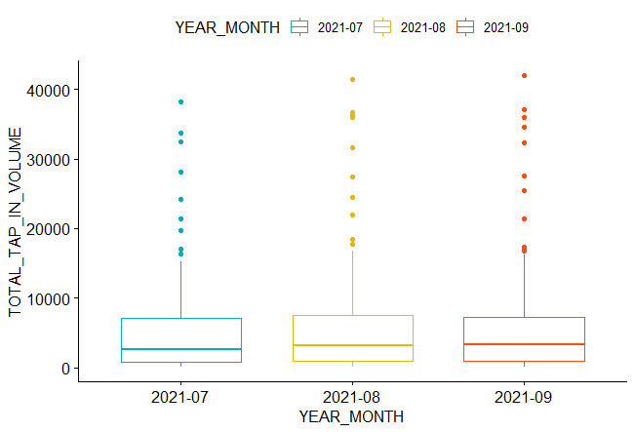
2nd Statistical Test - Results
P-values for all 6 tests obtained were all greater than 0.05.
Conclude at 95% confidence level that the mean arrivals per hour are NOT statistically different between each month.
Hence our assumption that the distribution of passenger arrivals come from the same distribution is valid.
On the right is a boxplot to visualize just 1 of the 6 tests.
Box-plot Passenger tap-in volume for weekday morning peak hours.
40.015 Simulation Modeling and Analysis | Mass Rapid Transit System Line Simulation

Slide 11
Data Manipulation
Process:
Identify which observations are from morning peak hours, evening peak hours, and non-peak hours;
Identify which stations are connectors to other lines and spilt the arrivals accordingly;
Calculate the mean number of hourly arrivals (tap in) for the 6 identified groups.
DAY_TYPE | TIME_PER_HOUR | PT_TYPE | PT_CODE | TOTAL_TAP_IN_VOLUME | TOTAL_TAP_OUT_VOLUME
WEEKDAY | 22 | TRAIN | NS28 | 730 | 137
WEEKENDS/HOLIDAY | 22 | TRAIN | NS28 | 387 | 83
WEEKDAY | 0 | TRAIN | DT10 | 10 | 55
WEEKENDS/HOLIDAY | 0 | TRAIN | DT10 | 3 | 28
WEEKDAY | 10 | TRAIN | EW16/NE3 | 14824 | 21782
WEEKENDS/HOLIDAY | 10 | TRAIN | EW16/NE3 | 4243 | 5240
WEEKENDS/HOLIDAY | 9 | TRAIN | CC14 | 2172 | 1053
For example, calculating mean for Weekday Non-Peak for DT line
WEEKENDS/HOLIDAY | 15 | TRAIN | CC25 | 2754 | 1672
WEEKENDS/HOLIDAY | 12 | TRAIN | CE1/DT16 | 4133 | 8609
WEEKDAY | 12 | TRAIN | CE1/DT16 | 6343 | 11666
WEEKDAY | 10 | TRAIN | SW6 | 2492 | 1350
40.015 Simulation Modeling and Analysis | Mass Rapid Transit System Line Simulation

Slide 12
Results: Simulation Parameters
Average number of passenger arrivals per hour:
 | Morning Peak | Evening Peak | Non-Peak
Weekday | 5100 | 7980 | 3480
Weekend | 840 | 1980 | 1380
From the above values, we can then sample and create timeseries data such that we can run 1 day (finite cycle) of simulation using the non-stat Exponential Distribution in JaamSim. More details in the Model Documentation slides.
40.015 Simulation Modeling and Analysis | Mass Rapid Transit System Line Simulation

Slide 13
Limitations
Regarding the data distribution:
Although we claim that the passenger arrivals follow a Poisson distribution, the sample mean is observed to exceed the sample variance (overdispersion).
Since the data is over dispersed, a Negative Binomial distribution might be more appropriate in providing an estimate for the passenger arrival rate.
Regarding the LTA API:
Does not provide the passenger tap-in volume across the whole day itself. Latest addition to the API only provides passenger volume across the day in categorical form (Low/Middle/High) which is not beneficial for our simulation modeling. Similar issue when using Google Popular Times view.
Insufficient points for each station (currently 1 per month, and we only have 3 months). Hence, we can only validate and assume all the stations have the same passenger interarrival times.
40.015 Simulation Modeling and Analysis | Mass Rapid Transit System Line Simulation

